Slide 1


Airbnb NYC Listings: A Data Analysis Project
By Andavarapu vamsi ,The project presents a comprehensive data analysis of Airbnb listings in New York City. Completed in June 2025, it aims to uncover key trends and insights from a real-world dataset.

Slide 2

Project Overview and Objectives
1
Abstract
2
Introduction
Comprehensive data analysis of over 37,000 Airbnb listings in NYC, uncovering trends in pricing, availability, host activity, and neighborhood dynamics across the five boroughs.
Examines NYC's short-term rental market dynamics, providing actionable insights for hosts, guests, and stakeholders by analyzing price distribution, room types, and review patterns.
3
System Requirements
4
Project Architecture
Details the necessary software (Python 3.8+, libraries, Jupyter) and hardware (Intel i3+, 4GB RAM, 2GB storage) for project execution.
Outlines the systematic workflow from data ingestion to insights, including data exploration, cleaning, analysis, visualization, and reporting.

Slide 3
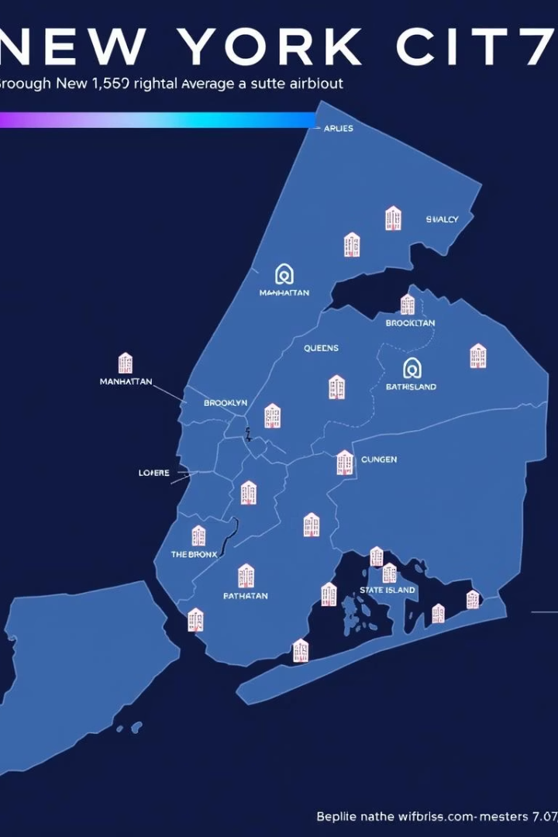
Abstract: Uncovering NYC Airbnb Insights
This project conducts a comprehensive data analysis of over 37,000 Airbnb listings in New York City. The primary goal is to reveal key trends and insights regarding pricing, availability, host activity, and neighborhood dynamics across NYC's five boroughs. The analysis involves data exploration, cleaning, addressing missing values and outliers, and engineering new features like room type categories and price segments.
Descriptive statistics and visualizations highlight significant price differences among boroughs, with Manhattan being the most expensive. The study identifies popular neighborhoods and hosts, along with the distribution of room types and their location-based relationships. Correlation analysis further explores the interplay between variables such as price, reviews, and availability.

Slide 4

Introduction to NYC Airbnb Data Analysis
The Airbnb NYC Listings Data Analysis Project delves into the vibrant short-term rental market of New York City. Utilising a dataset of over 37,000 listings across the five boroughs, this analysis aims to uncover key patterns in pricing, availability, host activity, and neighborhood characteristics.
The project's objective is to provide actionable insights for hosts to optimise listings, for guests to find suitable accommodations, and for stakeholders to understand market trends. By examining variables like price distribution, room types, review patterns, and geographical distribution, this study reveals the complex factors shaping NYC's Airbnb ecosystem.

Slide 5

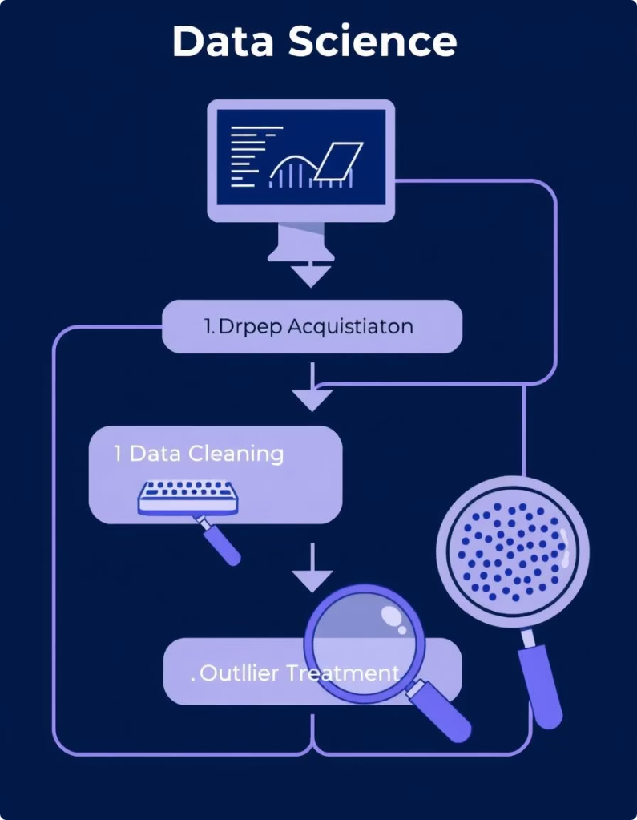




Project Methodology: A Structured Approach
Data Acquisition
Dataset with 19 columns, including IDs, host info, geographical data, pricing, and review metrics.
Data Preparation
Handling missing values (reviews_per_month, name, host_name), converting price to float, and last_review to datetime.
Feature Engineering
Creating room_type_category, price_category, review_month, and availability_status for enhanced analysis.
Outlier Treatment
Applying IQR-based filtering for extreme price values and log transformation for normalization.
This structured data science workflow ensures thoroughness and accuracy in analysing the Airbnb dataset, leading to robust and actionable insights.

Slide 6
System Requirements for Project Execution
Software Requirements
Hardware Requirements
Operating System: Windows 10+, macOS, or modern Linux.
Processor: Intel i3 (8th gen) or AMD equivalent (minimum); Intel i5/i7 or AMD Ryzen (recommended).
Python Environment: Python 3.8 or higher.
Python Libraries: numpy, pandas, matplotlib, seaborn (for data analysis and visualisation).
RAM: 4 GB (minimum); 8 GB or higher (recommended for large datasets and multitasking).
Additional Tools: Jupyter Notebook/JupyterLab (for interactive development), modern web browser, PDF reader.
Storage: At least 2 GB free disk space for dataset, Python environment, and output files.

Slide 7







Project Architecture: Workflow Stages
Data Ingestion
Importing essential Python libraries (NumPy, pandas, Matplotlib, Seaborn) and loading the Airbnb dataset.
Data Exploration
Initial inspection of dataset shape, column information, data types, and generating basic statistics.
Data Preparation & Cleaning
Handling missing values, type conversion, feature engineering, and outlier treatment.
Data Analysis & Querying
Statistical summaries, groupings, identifying trends, and correlation analysis.
Visualization
Using Matplotlib and Seaborn to create plots and charts for better understanding and communication.
Insights & Reporting
Extracting key insights, summarising findings, and providing actionable recommendations.
Documentation & Export
Documenting workflow, code, and results in a Jupyter notebook, exported as a PDF with appendices.

Slide 8






Key Data Analysis Libraries Utilised
NumPy
Pandas
Matplotlib
Provides support for large, multi-dimensional arrays and mathematical functions for efficient numerical computations and handling missing values.
Offers powerful data structures (Series, DataFrame) for loading, cleaning, manipulating, aggregating data, and feature engineering.
A comprehensive library for creating static, animated, and interactive visualisations like histograms and bar charts to explore data.
Seaborn
Built on Matplotlib, it provides a high-level interface for drawing attractive and informative statistical graphics, including boxplots and heatmaps.

Slide 9

Summary of Library Use Cases
NumPy
Numerical operations, mathematical functions, array handling
Pandas
Data loading, cleaning, manipulation, aggregation, feature engineering
Matplotlib
Basic data visualization (histograms, bar charts, etc.)
Seaborn
Advanced and statistical visualizations (boxplots, heatmaps, etc.)
These libraries collectively enable efficient data handling, in-depth analysis, and effective communication of results throughout the project, forming the backbone of our data science workflow.

Slide 10
About the Data: Initial Steps
1
Importing Libraries
2
Loading Dataset
3
Checking Shape and Info
We begin by importing all necessary Python libraries required for data manipulation and analysis.
The dataset is loaded into a pandas DataFrame for further processing.
We examine the dataset's dimensions and data types to ensure data integrity and readiness for analysis.

Slide 11
Initial Data Display
To get a quick overview of the dataset's structure and content, we display the first two and last three rows of the DataFrame.
display(df.head(2))display(df.tail(3))
id
name
host_id
host_name
neighbourhood_group
neighbourhood
latitude
longitude
room_type
price
reviews_per_month
calculated_host_listings
2595.0
Skylit Midtown Manhattan Spacious Studio
2845
Jennifer
Manhattan
Midtown
40.75356
-73.98559
Entire home/apt
240.0
0.26
2
5136.0
Spacious Family Friendly Duplex w/ Patio + Yard
7378
Rebecca
Brooklyn
Sunset Park
40.66265
-73.99454
Entire home/apt
216.0
0.03
2
37015
1.410270e+18
Amazing view Room
493623509
Ramiro
Manhattan
Hell's Kitchen
40.763070
-73.987230
Private room
125.0
0.0
1
37016
1.410290e+18
bedrooms apt. Great
493623509
Ramiro
Manhattan
Hell's Kitchen
40.763120
-73.987430
Entire home/apt
226.0
0.0
1
37017
1.410300e+18
Beautiful large studio in
14598000
Daniel
Manhattan
Hell's Kitchen
40.754236
-73.997471
Entire home/apt
150.0
0.0
1

Slide 12
Exploratory Data Analysis (EDA)
Our exploratory data analysis focuses on key aspects of the dataset to reveal patterns and insights. We investigate pricing trends, listing popularity, and host performance to understand the dynamics of the rental market.
This section highlights the most expensive and cheapest neighborhoods, along with listings that have garnered the most reviews.

Slide 13



Key Findings: Neighborhood Pricing & Popularity
Top 5 Expensive Neighbourhoods
Cheapest Neighborhoods
Most Reviewed Listings
The Bronx and Staten Island offer more budget-friendly options, with the lowest average prices across the boroughs.
Listings in Chelsea, Lower East Side, East Village, and Chinatown show the highest number of reviews, indicating their popularity among guests.
Manhattan consistently holds the highest average prices for Airbnb accommodations, reflecting its prime location and demand.

Slide 14
Most Reviewed Listings
Listings with the highest number of reviews indicate significant popularity and guest engagement. These neighborhoods are highly sought after by visitors.
name
number of reviews
neighbourhood
Safe and Cozy Hostel Room, 1 person, Manhattan
3047
Chelsea
Individual Cubicle Room in NYC/Mixed Floor
2500
Chelsea
Untitled at 3 Freeman - Studio Queen
2065
Lower East Side
Amazing Micro Unit W/ communal rooftop and kit
1954
East Village
SoHo View Room (Full-Size Bed) in Hotel Comfort
1809
Chinatown

Slide 15



Highest Rated Hosts
Candlewood Suites Times Square New York City
This host consistently receives high average reviews per month, indicating strong guest satisfaction.
Alfred
Alfred also demonstrates high guest satisfaction and/or activity, reflected in their average reviews per month.
Guest Satisfaction
High review rates suggest excellent service and positive guest experiences.

Slide 16
Room Type Distribution by Borough
Crosstabulation analysis reveals how different room types are distributed across the various boroughs, providing insights into local accommodation preferences.
room type
Entire home/apt
Hotel room
Private room
Shared room
Bronx
372
0
521
0
Brooklyn
3571
6
3680
56
Manhattan
5939
207
2475
29
Queens
1419
7
1777
30
Staten Island
152
0
156
0

Slide 17
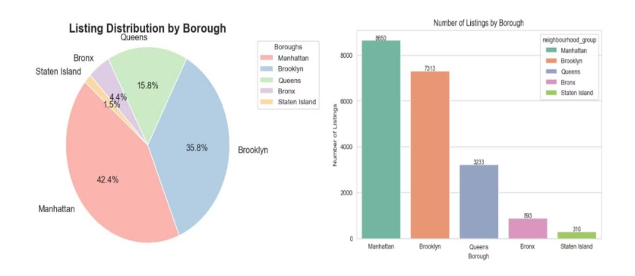
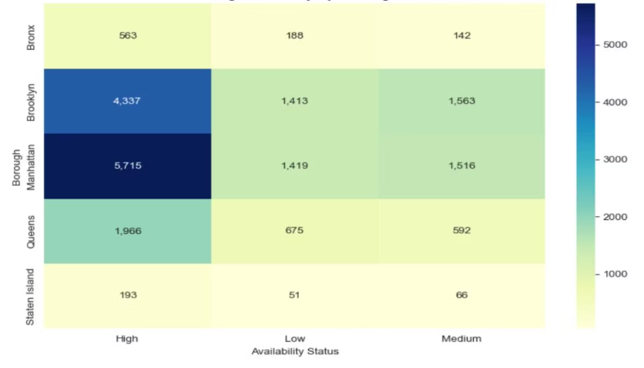
Data Analysis Queries & Visualizations
Price Analysis
Identified boroughs with the highest and lowest average prices to provide insights into market segmentation.
Room Type Trends
Assessed how room types vary by borough, revealing distinct preferences and offerings in different areas.
Availability
Categorized listings by annual availability and analyzed their distribution to understand market dynamics.

Slide 18

Advantages of Data Analysis Libraries
Efficient Data Handling
Pandas and NumPy enable fast and flexible reading, cleaning, and manipulation of large datasets, making tasks like filling missing values and type conversions straightforward.
Streamlined Preparation
Libraries offer built-in functions for handling missing data, removing duplicates, and transforming data types, reducing manual coding and errors. Feature engineering is also easily implemented.
Powerful Exploration
Quick generation of descriptive statistics, correlation matrices, and groupby summaries helps uncover key insights and answer specific business questions rapidly.
High-Quality Visualization
Matplotlib and Seaborn allow the creation of a wide range of plots to visualize trends, distributions, and relationships, making complex data patterns understandable for all audiences.

Slide 19




Conclusion: Actionable Insights & Recommendations
Enhanced Analysis
1
Feature engineering, like categorizing room types, deepened insights.
Market Trends
2
Manhattan is most expensive; Bronx/Staten Island are budget-friendly.
Popularity Drivers
3
Central, tourist-heavy neighborhoods and engaged hosts drive popularity.
Room Type Dominance
4
Entire homes dominate Manhattan, private rooms in outer boroughs.
This analysis highlights the diverse and dynamic nature of the NYC Airbnb market. Recommendations include hosts in less expensive boroughs offering value-added services and guests considering the Bronx and Staten Island for affordable stays. Further research could explore seasonality effects.

Slide 20




References & Further Exploration
Inside Airbnb – Get the Data
The primary dataset was sourced from Inside Airbnb, providing publicly available data on NYC listings. https://insideairbnb.com/get-the-data/
Inside Airbnb – New York City Overview
Additional context and data structure information were referenced from the Inside Airbnb New York City project page. https://insideairbnb.com/new-york-city/
Future Research
Explore the effects of seasonality and external events on pricing and availability to gain deeper insights into market fluctuations.

